Slide 1
Project 2

Slide 2
sources
Player Demographics:
http://www.seanlahman.com/baseball-archive/statistics/
Player Statistical Information:
https://baseballsavant.mlb.com/savant-player/

Slide 3
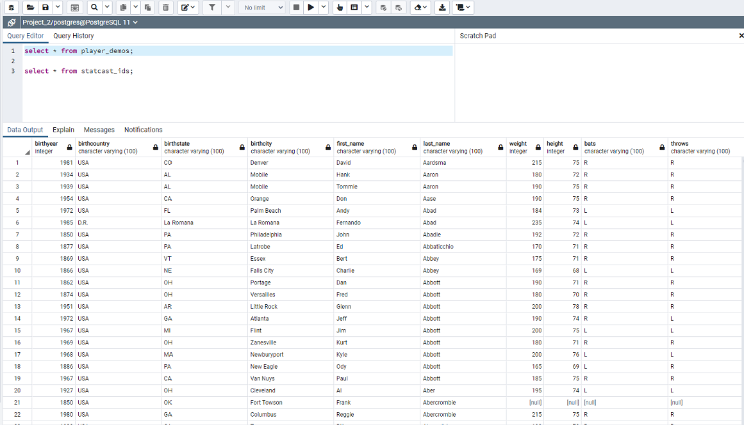
SQL Data Base
Notes:
Consider talking about:
Sabermetrics

Slide 4
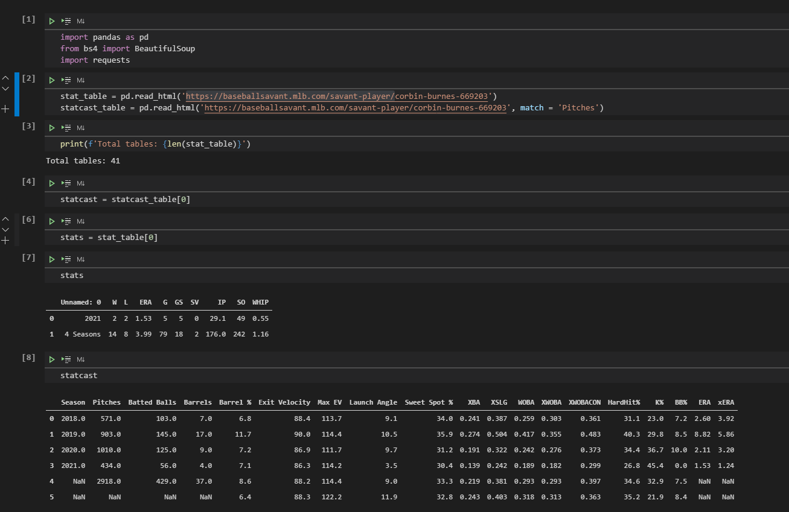
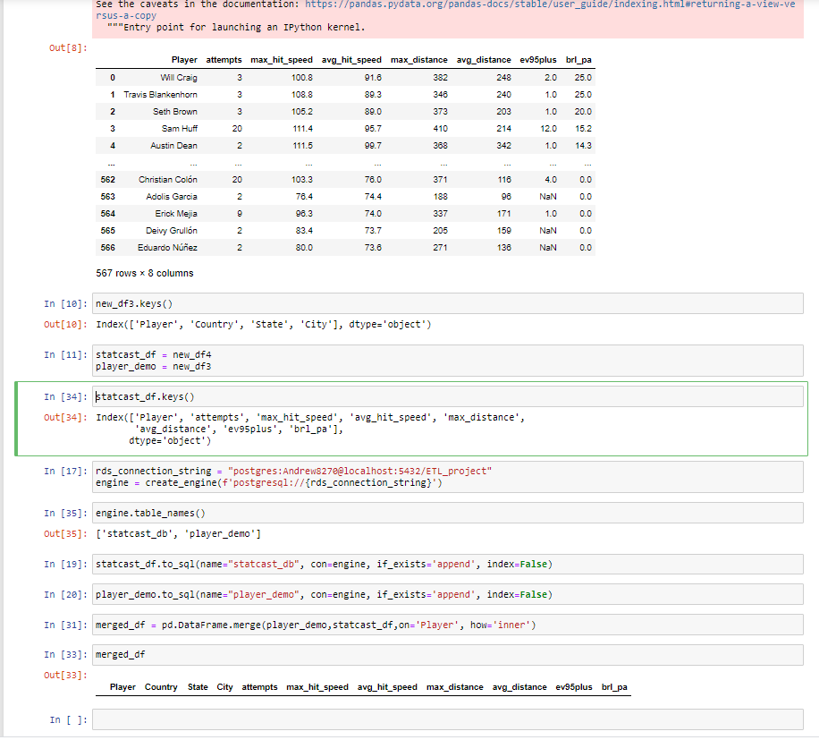
Web scrape
With
python

Slide 5
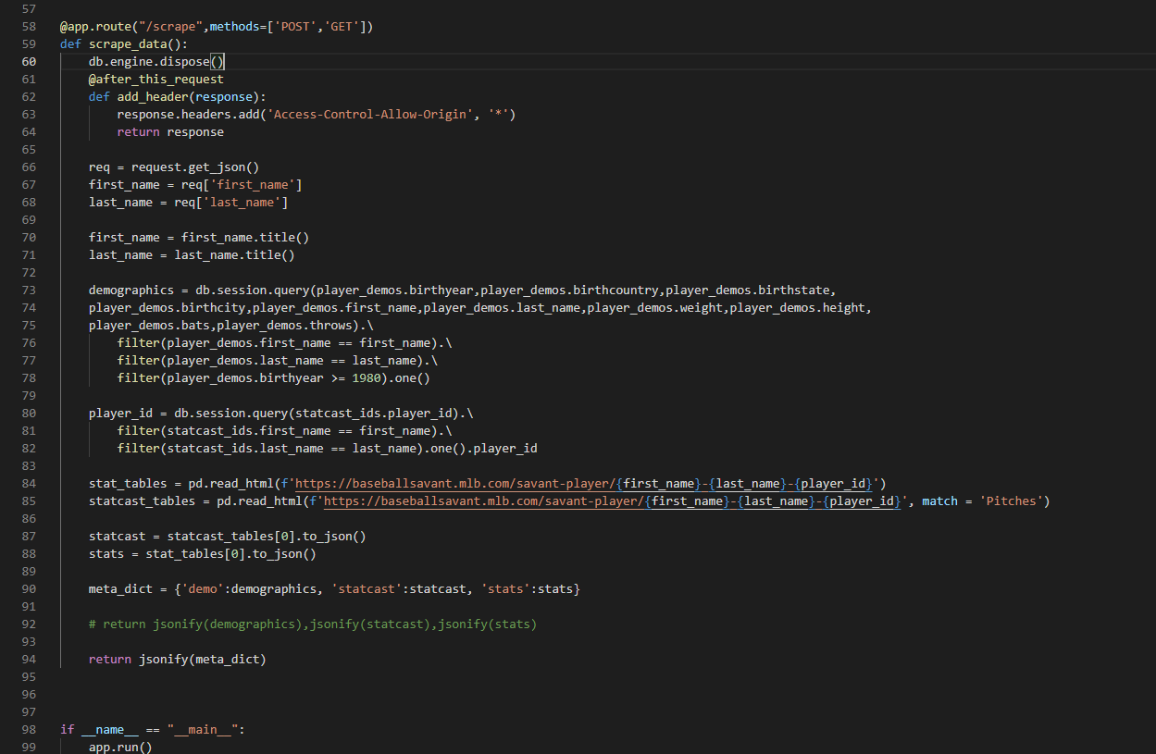
Build
Flask app

Slide 6
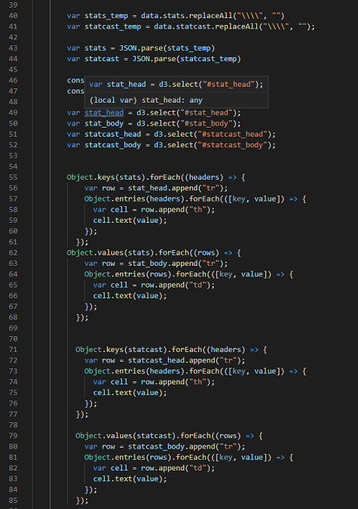
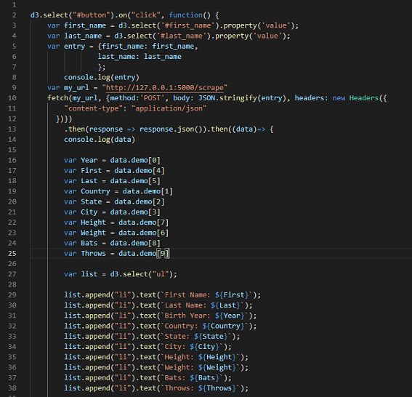
Javascript

Slide 7
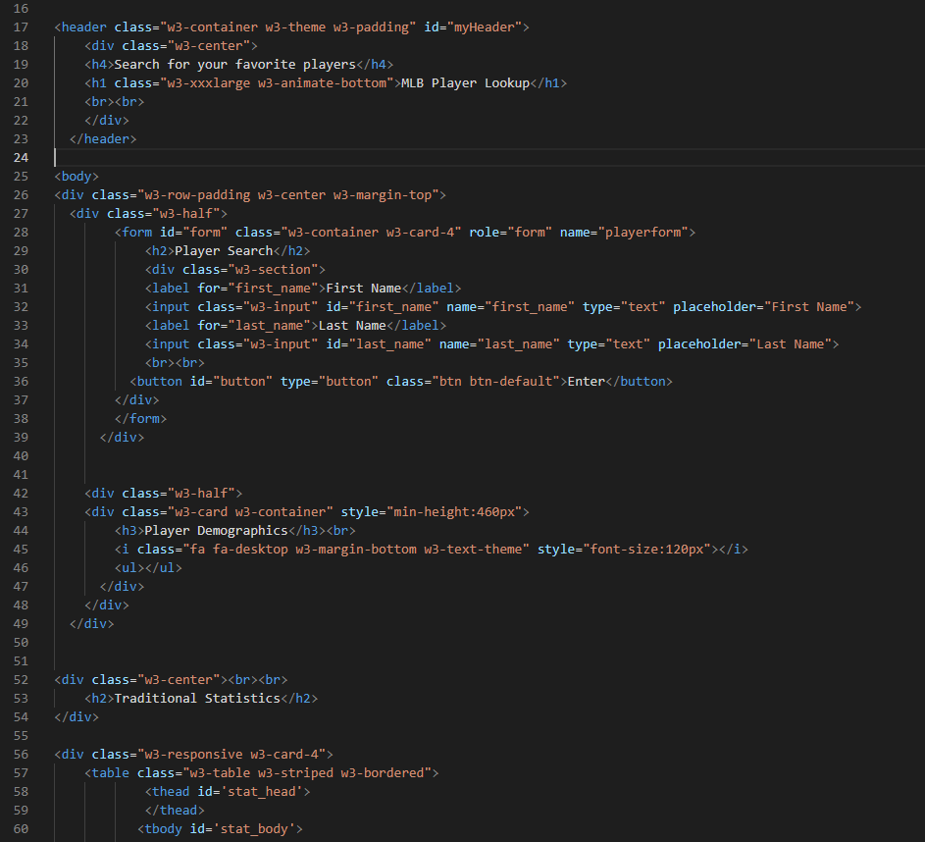
HTML

